Slide 1
Prediction of diabetes using health indicators
Big Data Technology (BIA-678-A) Fall 2021
Mentor: Prof. Dr. David Belanger
Abdulrazzak Moulvi, Deepanshu Negi, Rishi Singh

Slide 2



BIA 678A team project
Members
Abdul Razzak Moulvi
Information Systems
Graduate Student
Mumbai, India
Deepanshu Negi
Information Systems
Graduate Student
Mumbai, India
Rishi Singh Machine Learning Graduate Student
Benfleet, United Kingdom

Slide 3
Contents
Introduction
Aim
Data Understanding
Exploratory Data Analysis (EDA)
Data Cleaning
Technologies Used
Project Methodology
Choosing Classification Models
Imbalanced Dataset Results
SMOTE to balance the dataset
Balanced Dataset
Results
Performance Evaluation
Scalability Evaluation
Future Work
Conclusion

Slide 4
Introduction
What is Diabetes?
What are its types?
Diabetes in the 21 century is considered as one of the deadliest and chronic disease.
In the UK, around 90% of all adults with diabetes have type 2. Just over 1 in 10 people in the United States have diabetes and in 1 in 3 American adults have prediabetes.
Around 25% of the hospitalized people with the COVID-19 virus had diabetes.
Diabetes patients are at risk to develop serious complications and to die from the virus.

Slide 5
Aims
By using PySpark:
Understand the diabetes health indicator dataset and perform EDA.
Develop binary classification using machine learning algorithms to predict whether an individual has diabetes or not.
Evaluate the results produced by the machine learning algorithms along with their scalability and performance using AWS.

Slide 6
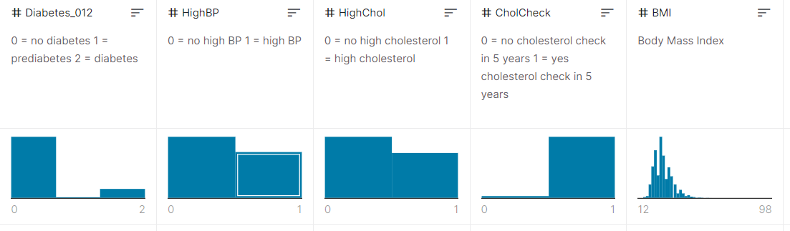
Data Understanding
Columns representing the important aspects of prediction.
Most of the data was in zeros and ones.
Body Mass Index (BMI) in its standard form.

Slide 7
Exploratory Data Analysis

Slide 8
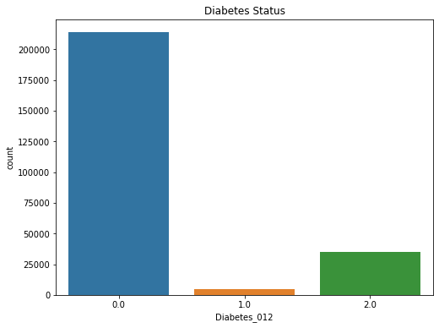
Diabetes Status

Slide 9
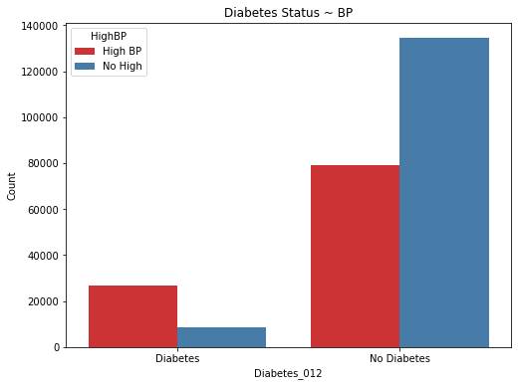
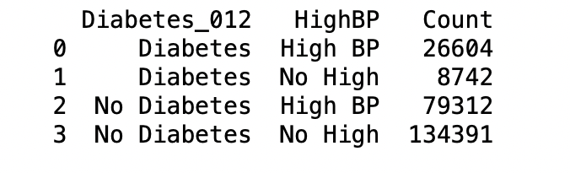
Diabetes status with respect to Blood Pressure

Slide 10
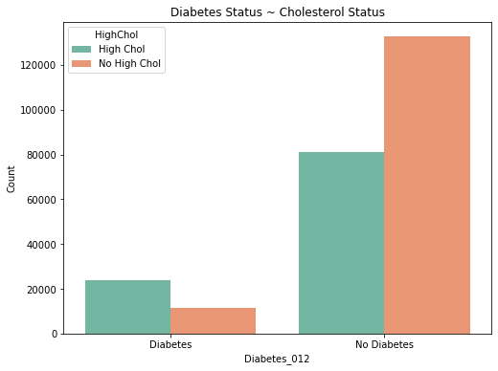
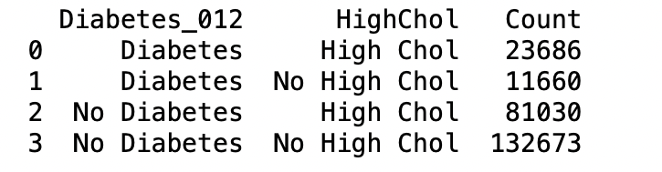
Diabetes Status with respect to Cholesterol

Slide 11
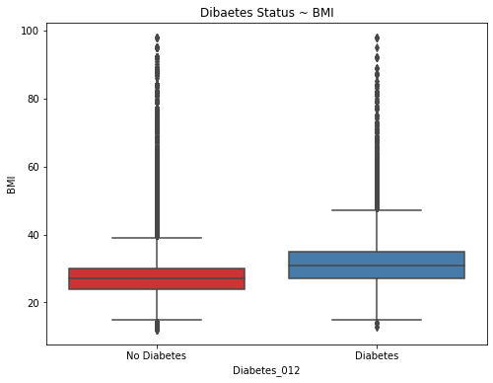
Diabetes Status with respect to BMI

Slide 12
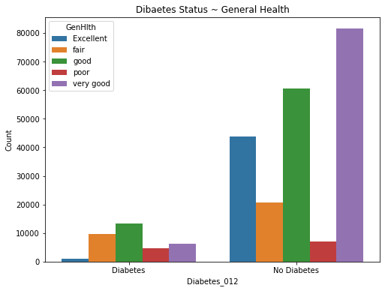
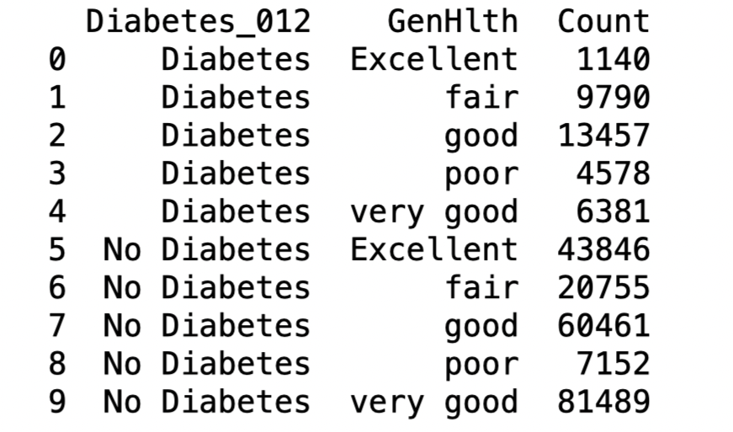
Diabetes Status with respect to General Health

Slide 13
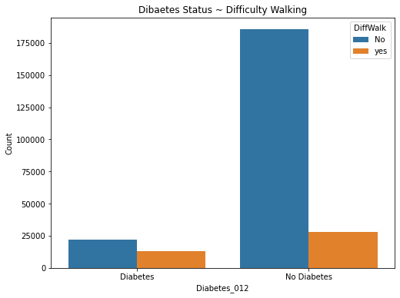
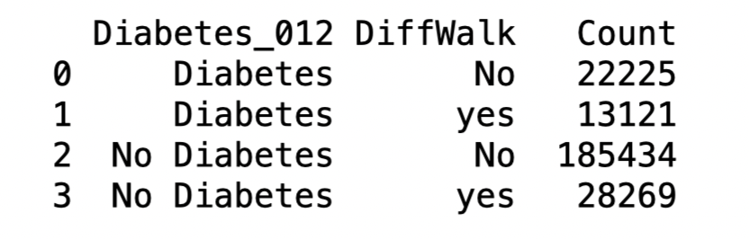
Diabetes Status with respect to
Walking difficulty

Slide 14
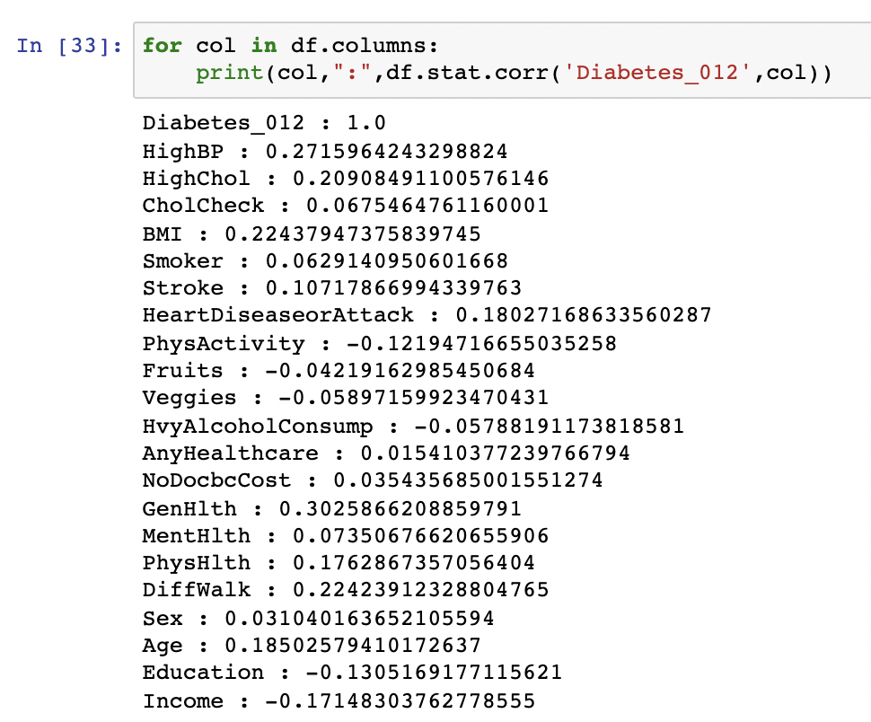
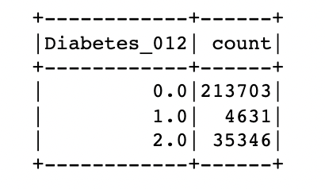
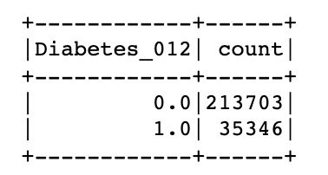
Data Cleaning
Searched for NULL/NA values.
Dataset was cleaned at a good standard with most columns consisting of binary values.
After EDA, a correlation of all features and the Diabetes_012 was computed.
Prediabetes was removed from the dataset.

Slide 15






Technologies Used

Slide 16
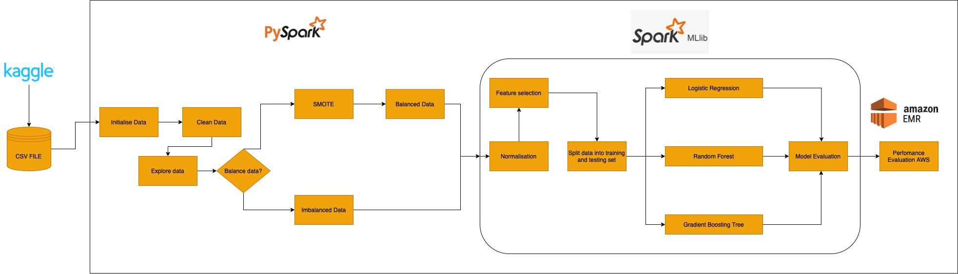
Project Methodology

Slide 17
Choosing classification models
Logistic Regression:
Uses the sigmoid function which is an s shaped curve and maps real world values into value between 0 and 1.
Random Forest Classifier:
Consists of the combination of multiple decision trees. This ensemble approach uses the majority output of various trees to make a prediction.
Gradient Boosting Tree:
Involves predictors trying to improve on predecessors by reducing error.

Slide 18
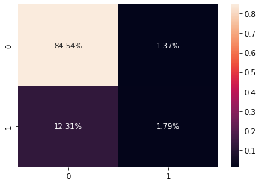

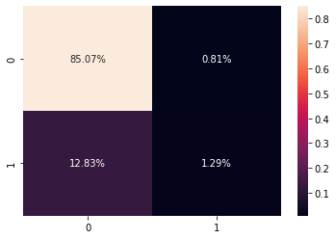
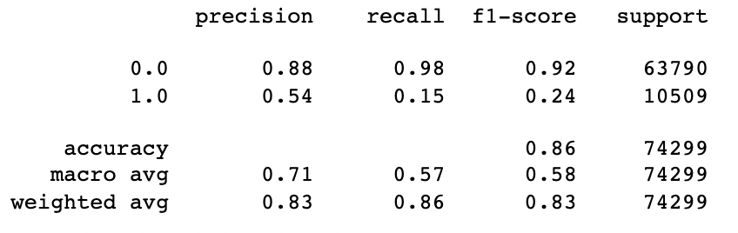
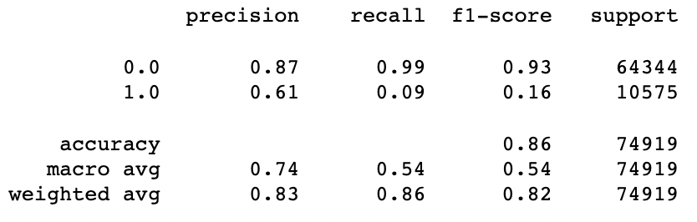
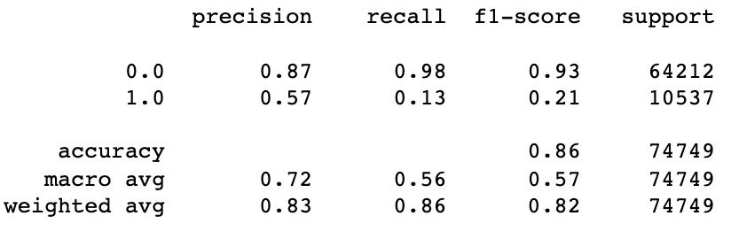
Imbalanced Dataset Results
Logistic Regression
Random Forest Classifier
Gradient Boosting Tree

Slide 19
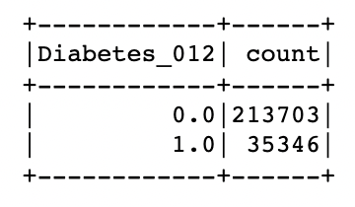
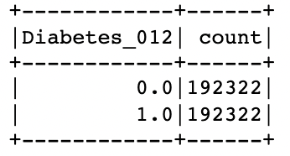
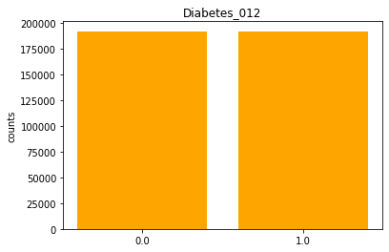
SMOTE to balance dataset
Synthetic Minority Oversampling Technique (SMOTE).
Oversampling the minority class.
This can method duplicates examples from the minority class prior to the fitting of the model.

Slide 20
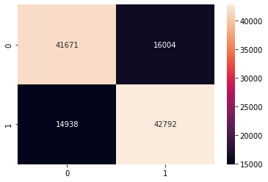
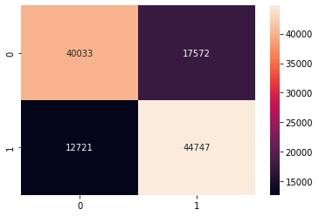
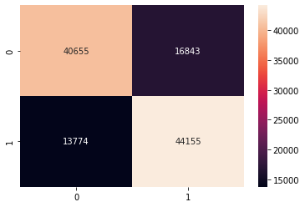
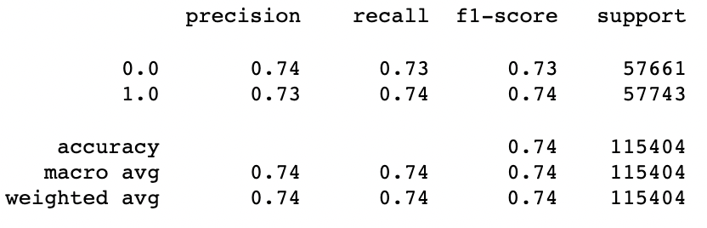
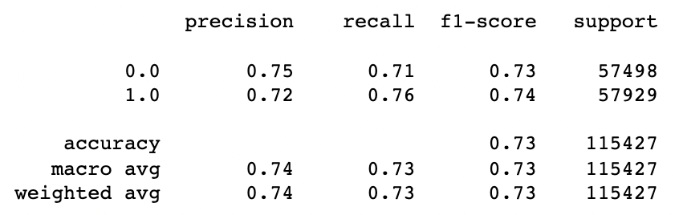
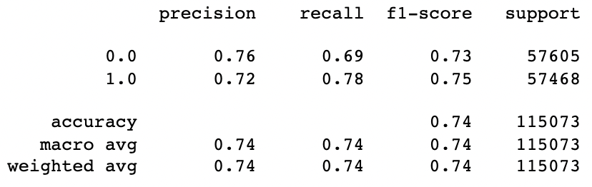
Balanced Dataset
Logistic Regression
Random Forest Classifier
Gradient Boosting Tree

Slide 21
Results
We believe the Logistic Regression model created is the best suited model as it provides the best balance between the precision and recall compared to the other two models.
In an imbalanced dataset we obtained high accuracy results for classifying people with no diabetes but poor results for predicting people with diabetes.
Using SMOTE we were able to oversample the data and achieved better results to represent the three models.

Slide 22
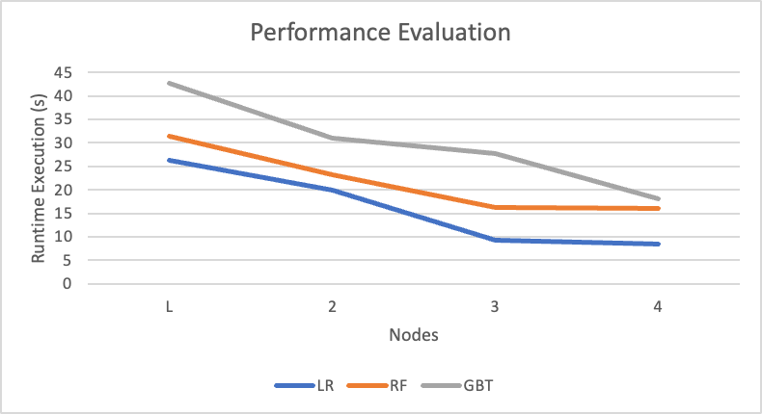
Performance Evaluation
This figure represents the performance of the three machine learning models as the number of nodes change and the shift between the modes being run on a local machine and AWS EMR.

Slide 23
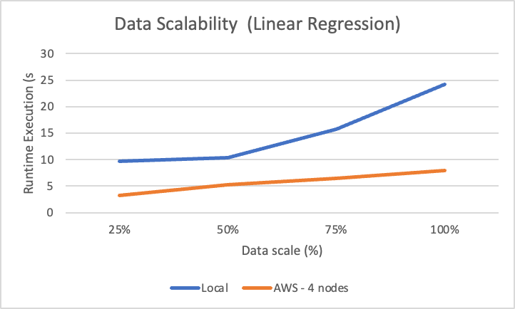
Scalability Evaluation

Slide 24
Future Work
Principal Component Analysis instead of correlation function.
Hyper tuning parameters and using grid search to obtain optimal parameters
Google Cloud platform /Microsoft Azure platform to evaluate performance and scalability.
Obtain more data with a link to COVID-19 to further develop this project.

Slide 25
Conclusion
In this project the group successfully analyzed the health indicators diabetes dataset.
Developed a binary classification to predict diabetes on an imbalanced and balanced dataset along with comparing the performance of three classification algorithms.
Evaluated the performance of the models on AWS by tuning the number of nodes and evaluated the scalability of the models by sampling the amount of data and noting the runtime.

Slide 26
Thank You

Slide 27
References
https://www.nhs.uk/conditions/diabetes/#:~:text=Type%202%20diabetes%20is%20far,is%20known%20as%20gestational%20diabetes
https://www.who.int/news-room/fact-sheets/detail/diabetes
https://www.section.io/engineering-education/introduction-to-random-forest-in-machine-learning/
https://www.kaggle.com/alexteboul/diabetes-health-indicators-dataset
http://amunategui.github.io/smote/
https://www.dataschool.io/simple-guide-to-confusion-matrix-terminology/

